Slide 1
Reading Specialist Meeting
December 13, 2010
Jon Allaire
Ryan McNavage

Slide 2
WC Updates
New software version release on 12/16/2010
Software update will correct WC for TRC levels 10-16
From now on TRC levels 10-16 WC scores must be entered
  Scores are not part of the criteria for determining the final book level

Slide 3
How to Get the Update
Hot sync twice to get the update
What if I forget to hot sync
A reminder e-mail will be sent on 12/17/2010 with software version number

Slide 4
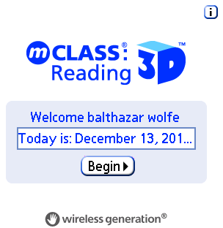
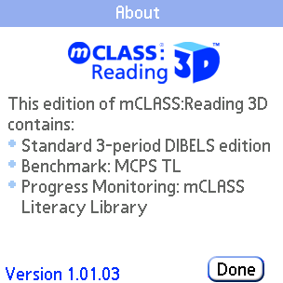
Preparation for MOY
Hot sync twice before MOY
Check the software version number
Note: the Correct version number is 1.05.12

Slide 5
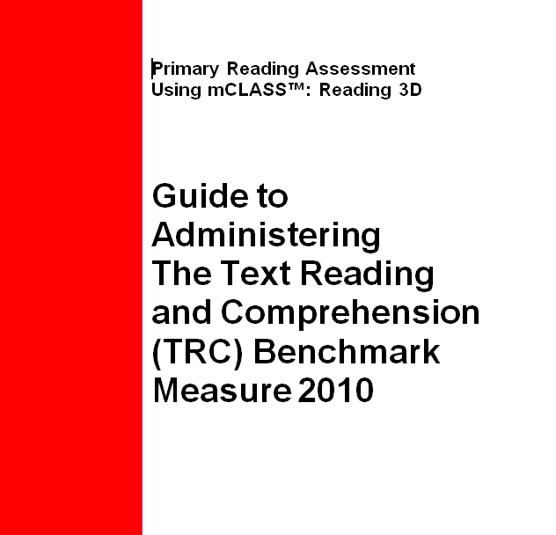
Best Practices
Hot synch on the morning before testing the first student
Synch often
Once you start testing a student, finish testing the student on the same Palm
If issue with Palm during testing, create a Help Desk ticket (important for tracking purposes)
Synch with Outlook closed
If Palm gets hung up during synch process, do not synch until ITS has corrected issue
Refer to your TRC guide for questions on scoring and administration

Slide 6
Replacement Palms and Chords
Call the Help Desk or create a Unicenter ticket
Send the old Palms to the warehouse
Send cords to warehouse

Slide 7
New Testing Device
Looks different but works the exact same way
Configuring the new device
Soft reset on the new device

